Slide 1


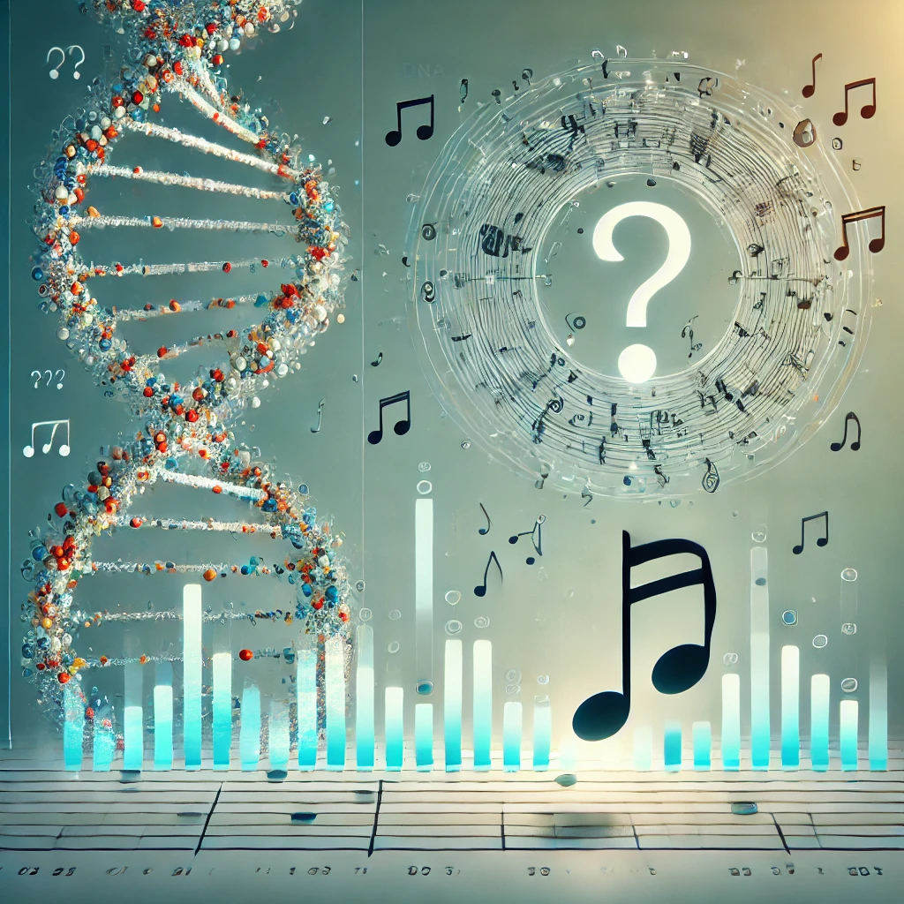
Gene Symphony: Can Musification Capture Patterns in Expression Data ?
Presented By : Goutham B (BE20B010)
Guide: Prof. Manikandan Narayanan
Committee: Prof. Karthik Raman, Prof. Nirav Bhatt
Indian Institute of Technology Madras
*Image generated using OpenAI DALL-E

Slide 2
Introduction
What is Sonification?
Translation of quantitative data into sound.
Provides a new sensory channel for data analysis.
What is Musification?
An extension of Sonification, which combines scientific data with musical composition for analytical and aesthetic purposes.
Scientific research has relied heavily on visual data representations such as graphs and heatmaps.
Visual representations can be limiting, particularly for those with visual impairments.
Blind: ~3.44% of total population have severe visual Impairments (based on a study in 2018*).
Color blind: ~4.5% of total population.
Challenging to interpret large volumes of information through traditional data presentation methods.
Sonification, and by extension musification, bridges this gap by making data accessible through sound, offering a unique opportunity for alternative data analysis.
*Ackland, P., Resnikoff, S., & Bourne, R. (2017). World blindness and visual impairment: despite many successes, the problem is growing. Community eye health, 30(100), 71–73.

Slide 3
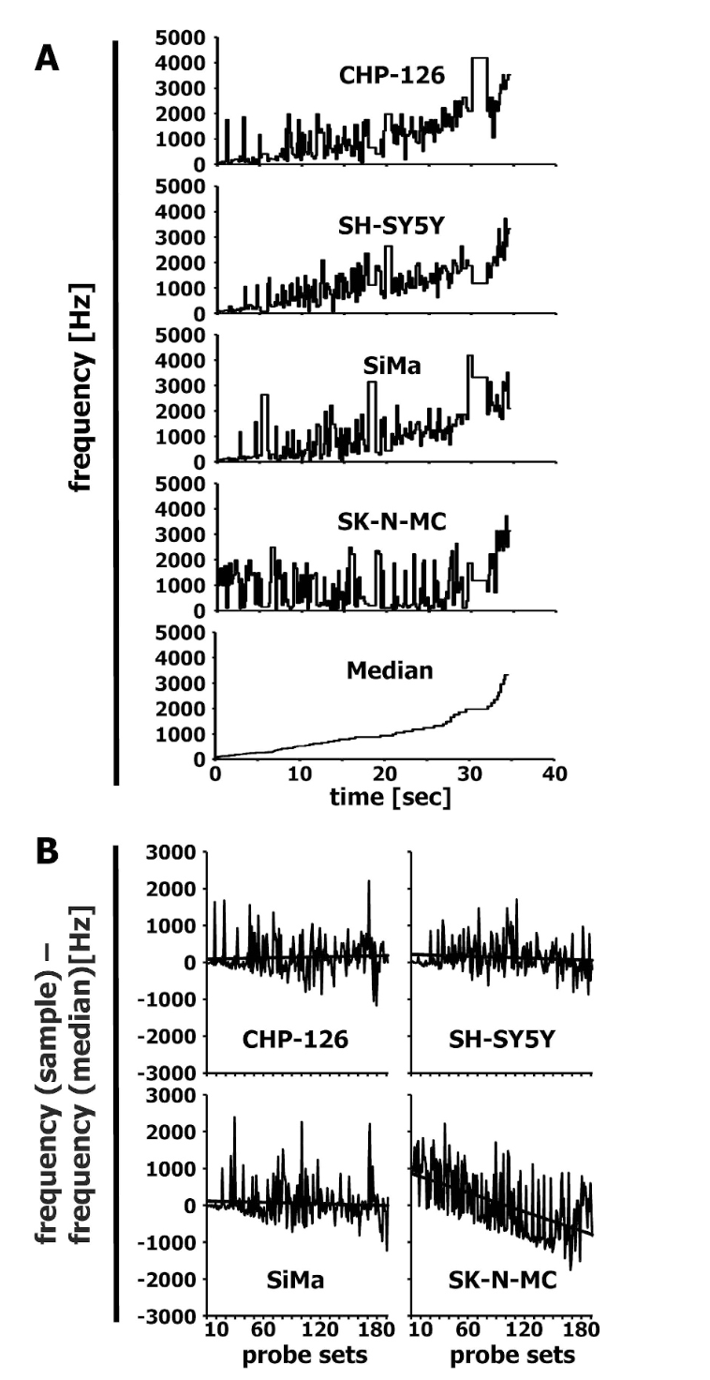
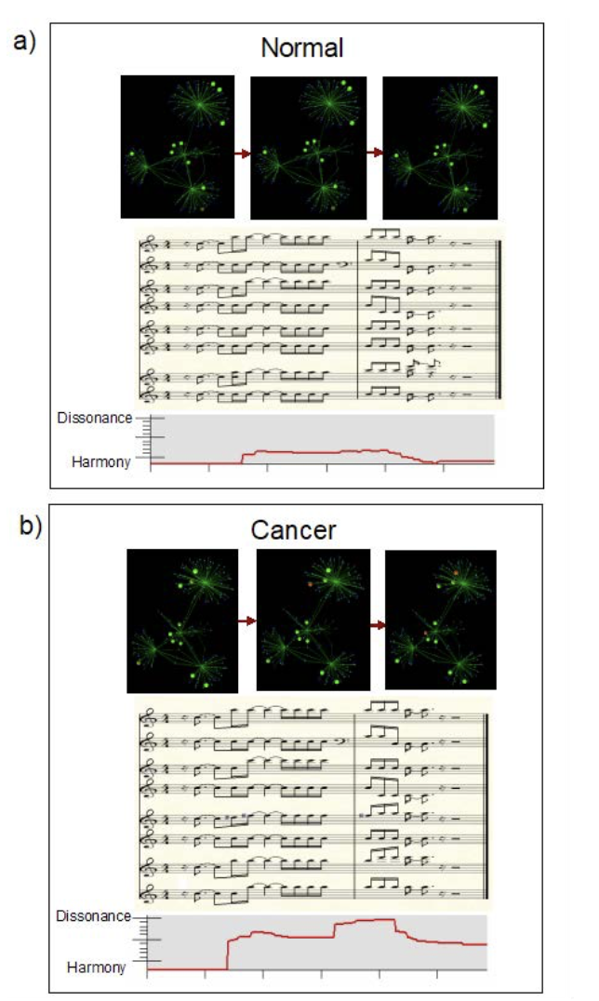
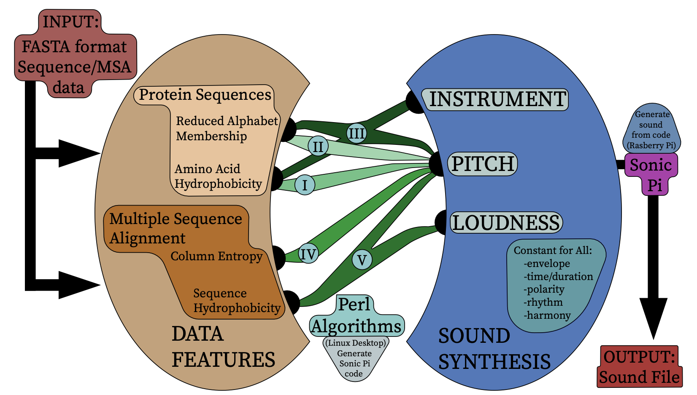
Literature Survey
Musification of DNA & Protein Sequences
Musification of Expression Data
Earliest Work: John Dunn’s Presentation on “Musical Interpretations of DNA Data”in 1989.
Recent work by Martin et al.(2021): Sonification techniques to analyse protein sequence data.
Static Expression Data
Time-Series Expression Data
Martin et al.(2021) Overview of Sonification of Amino Acid Sequences & MSA.
M.Staege (2015) Frequency Plots.
Alterovitz et al. (2022) Musical Insights.

Slide 4
Problem Statement
MOTIVATION
Sonification in biology is mostly limited to sequences & structure data.
Previous works on expression data focus on simplifying expression values across the “entire” gene set into a “single” musical representation, which may lead to data loss and overlook localized expression dynamics.
We bridge this gap by introducing a sonification mapping algorithm and music generation techniques that represent and analyze time-series gene expression through ’clusters’, offering an alternative approach to interpreting gene expression heatmaps and dendrograms.
AIM
“To represent an expression vector heatmap using musical outputs as a novel way of analyzing time-series gene expression clusters”
Input: A time-series gene expression vector of dimension G × T, where G is the number of genes and T is the number of time points
Output: Multiple clusters (total C) of genes with similar expression patterns and their corresponding musical audio representations.

Slide 5
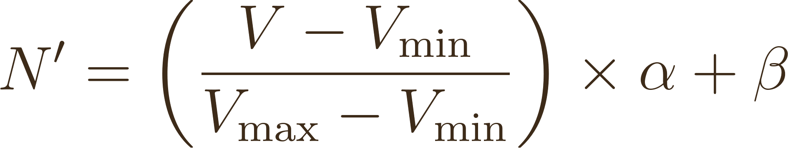
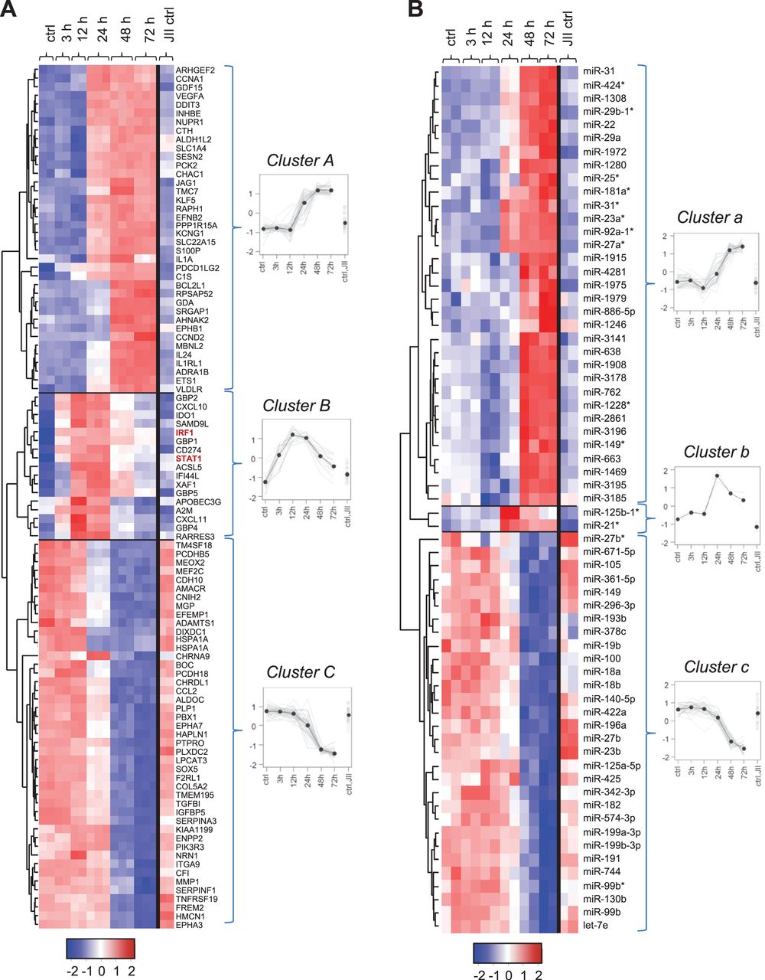
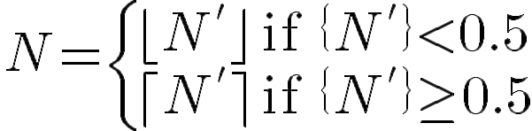






Methodology
Preprocessing: Clustering
2. Mapping Algorithm
Hierarchical clustering using Ward’s method.
Pairwise correlation for intra-cluster similarity.
Gao et al. (2022)
is the MIDI note of the gene
is the expression value of the gene
is the min expression value across all clusters
is the max expression value across all clusters
is set based on instrument ( = 87 for piano)
is a parameter which ensures notes are in
the MIDI range ( = 21 for piano)
MIDI: Musical Instrument Digital Interface
Nazarov et al. (2013) Hierarchical Clustering performed on a time-series data to get clusters

Slide 6
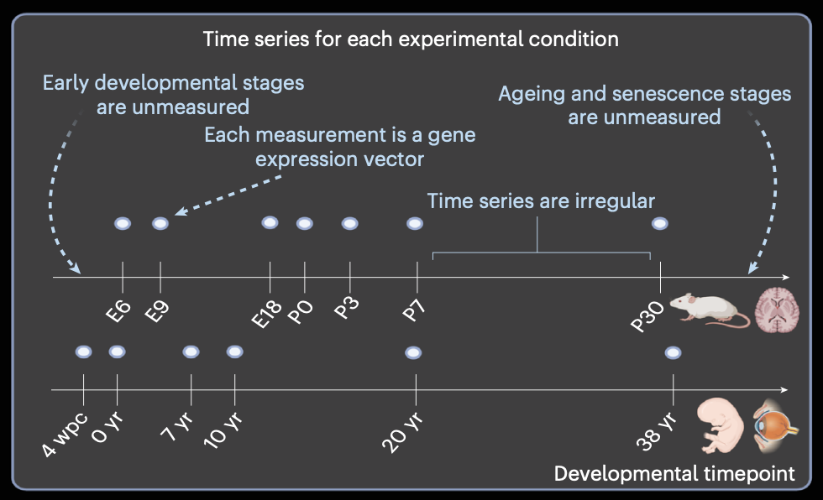
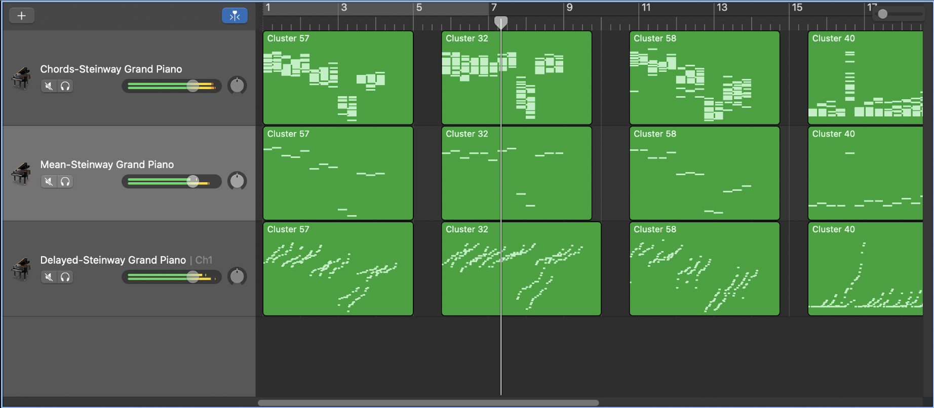
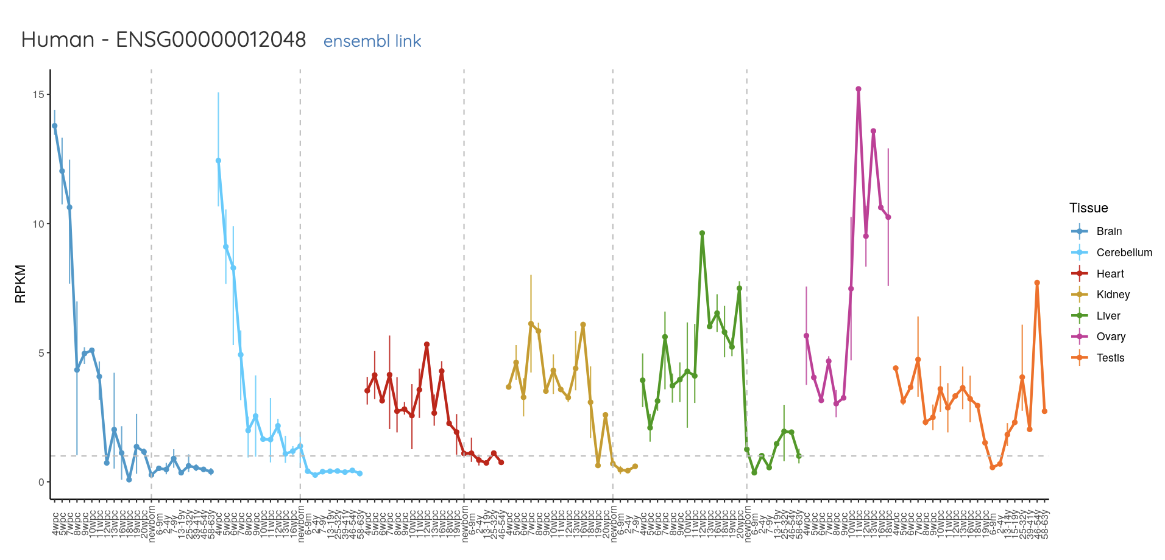
Methodology
3. Generating Music & Variants
4. Data Used
Chords: Each time point forms a chord with all cluster genes represented as simultaneous notes.
Mean: Each time point is represented by a single note based on the mean expression level.
Delayed: Notes within a time point are played sequentially in ascending order, creating an “arpeggio-like” pattern.
Woicik et al. (2023) Evo-Devo time points.
BRCA1 Gene
Utilizing the GarageBand Software for Music Variants Visualization
Kaessmann Lab, Expression Pattern of BRCA1 Gene in Human.

Slide 7
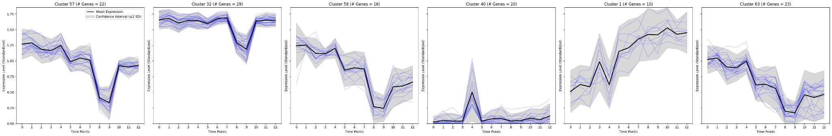
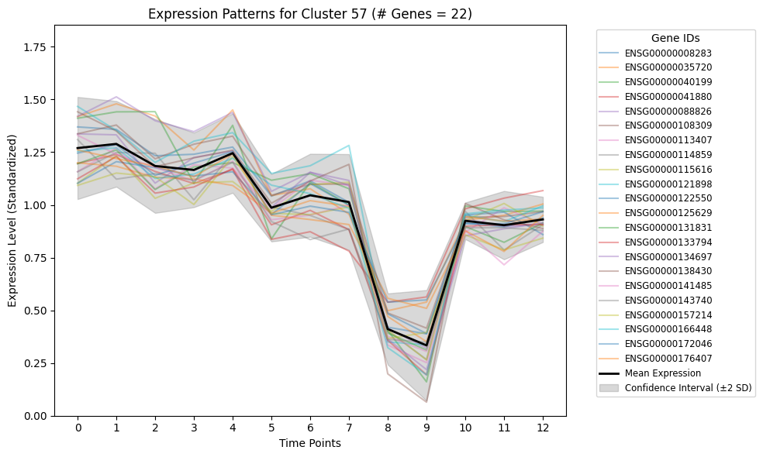

Results
Figure 1: Expression Patterns for six top ranked clusters based on pairwise correlation.
TYPE/LABEL | “57” | “32” | “58” | “40” | “1” | “63”
CHORDS
MEAN
DELAYED
COMBINED
Figure 2: Expression Patterns for “57” containing 22 genes from the Human-Brain expression vector.

Slide 8
Conclusion
Each cluster's music captures expression trends, with high-pitched notes for highly expressed genes and low-pitched notes for lowly expressed ones.
Comparative Analysis of Different Studies on Sonification in Biology
Work | Type | Target Audience | Purpose | Data Used | Sonification Method
Martin et al. (2021) | Protein Sequences | Scientists & Visually Impaired Individuals | Alternate analysis for Protein Sequences & MSA | Multiple Protein Sequences (Insulin, Histones etc.) | Parameter Mapping Sonification (PMSon)
Franjou et al. (2019) | Protein Sequences & Structures | Any Individual | Aesthetics/Design New Proteins Using Music | Protein Sequences & Structure Data | Not mentioned
M. Staege (2015) | Static Gene Expression | Scientists & Visually Impaired Individuals | Differential Gene Expression | Expression Data for Neuroblastoma Cell Lines | Scaled Linear Mapping
Alterovitz et al. (2022) | Time-Series Gene Expression | Hospitals & Doctors | Patient Monitoring | Expression Data for Colon Cancer Cell | Pythagorean Tuning
OURS (2024) | Time-Series Gene Expression | Scientists & Visually Impaired Individuals | Alternate analysis for Clusters & Heatmap/Aesthetics | Evolutionary Developmental Biology (Evo-Devo) | Normalized Linear Mapping

Slide 9
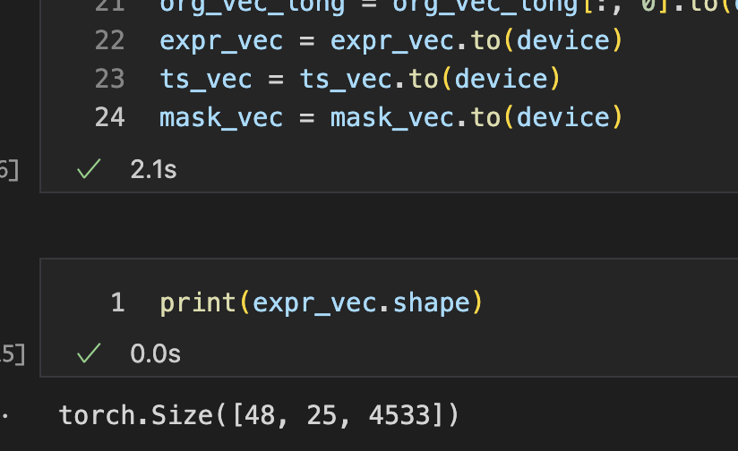
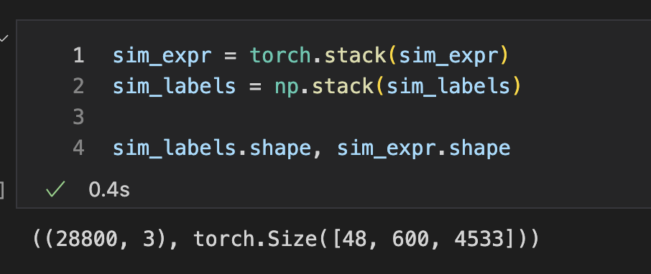
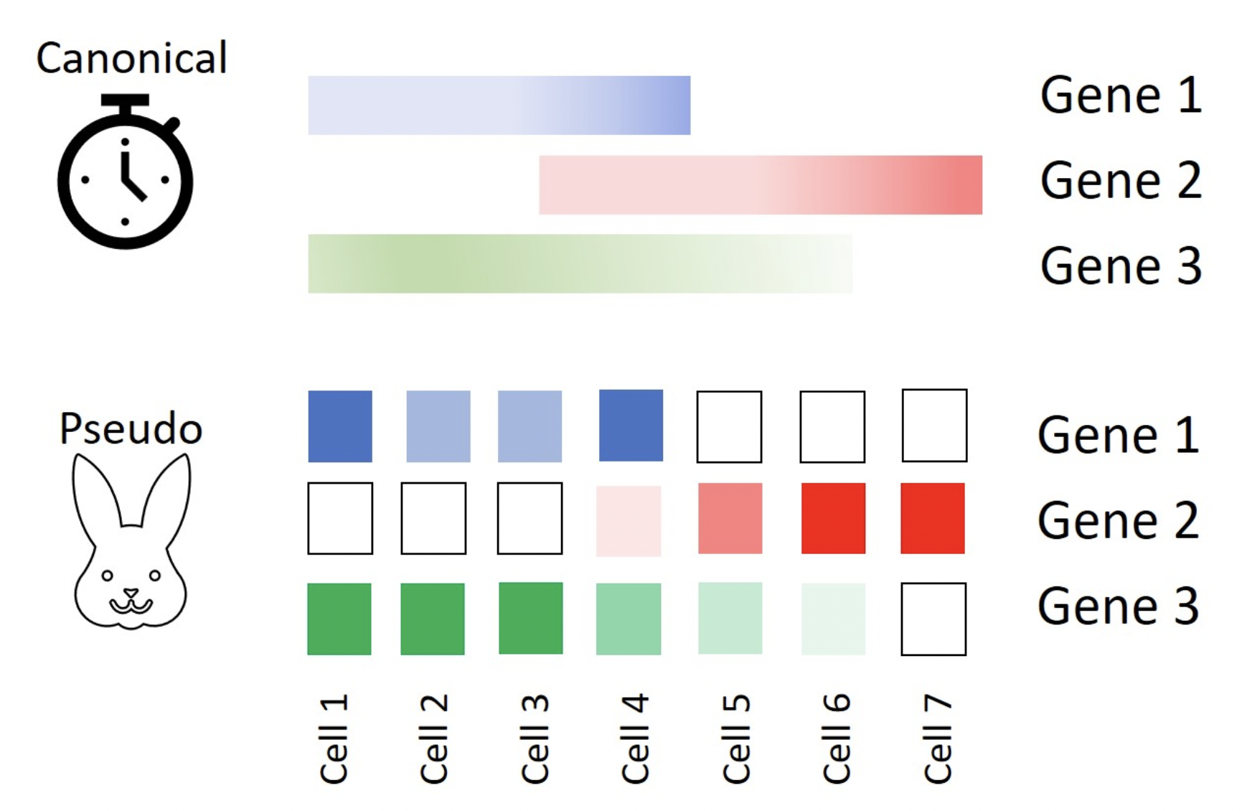
Future Work
Evaluation Strategies: Conduct group discussions or surveys where participants interpret graphs from musical samples to assess the effectiveness of music in conveying data patterns.
Enhanced Temporal Resolution: Use tools like Sagittarius (Woicik et al., 2022) to extrapolate unmeasured gene expression data, improving the granularity of time-series musical representations.
Integration of Pseudotime Analysis: Leverage pseudotime to map dynamic biological processes into music, reflecting temporal evolution and cellular state transitions.
Diverse Compositions with MusicLMs: Employ Music Language Models to generate high-fidelity variations of musical representations, enriching perspectives and interpretability.
Sagittarius
Pseudotime Analysis.
(Source: CellGS website*)
*https://www.cellgs.com/blog/pseudotime-vs-actual-time-for-genes.html

Slide 10
Key References
Martin, E.J., Meagher, T.R. & Barker, D. Using sound to understand protein sequence data: new sonification algorithms for protein sequences and multiple sequence alignments. BMC Bioinformatics 22, 456 (2021). https://doi.org/10.1186/s12859-021-04362-7
Staege, M. A short treatise concerning a musical approach for the interpretation of gene expression data. Sci Rep 5, 15281 (2015). https://doi.org/10.1038/srep15281
Alterovitz G, Yuditskaya S (2022) Musical Gene Expression: Abstracting High-Dimensional Gene Dynamics. J Biotechnol Biomater, 12: 280. DOI: 10.4172/2155-952X.1000280
Petr V. Nazarov, Susanne E. Reinsbach, Arnaud Muller, Nathalie Nicot, Demetra Philippidou, Laurent Vallar, Stephanie Kreis, Interplay of microRNAs, transcription factors and target genes: linking dynamic expression changes to function, Nucleic Acids Research, Volume 41, Issue 5, 1 March 2013, Pages 2817–2831, https://doi.org/10.1093/nar/gks1471
Woicik, A., Zhang, M., Chan, J. et al. Extrapolating heterogeneous time-series gene expression data using Sagittarius. Nat Mach Intell 5, 699–713 (2023). https://doi.org/10.1038/s42256-023-00679-5
Franjou, S. L., Milazzo, M., Yu, C. H., & Buehler, M. J. (2019). Sounds interesting: can sonification help us design new proteins? Expert Review of Proteomics, 16(11–12), 875–879. https://doi.org/10.1080/14789450.2019.1697236
Gao, Z., Wang, H., Feng, G., & Lv, H. (2022). Exploring sonification mapping strategies for spatial auditory guidance in immersive virtual environments. ACM Transactions on Applied Perception, 19(3), 1–21. https://doi.org/10.1145/3528171
THANK YOU!

